Slide 1
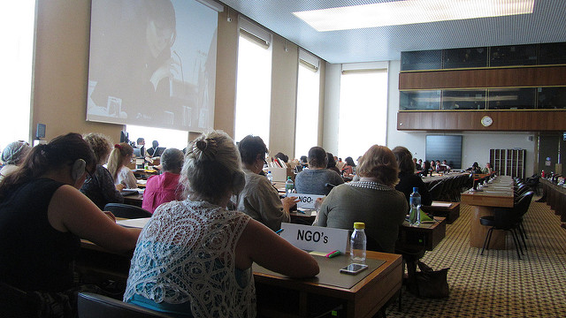
CEDAW for disabled women
Two Sisters of Frida joined the UK UN CEDAW delegation of women’s organisations to go to Geneva 2013

Slide 2
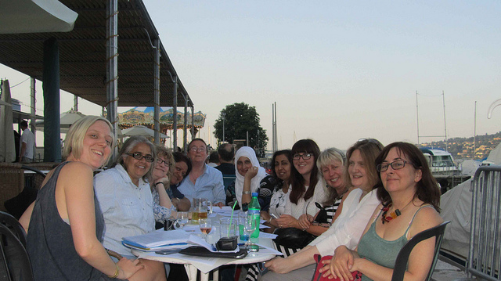
First, a tribute to Eleanor Firman
Eleanor Firman
Eleanor Firman went with us in 2013 - she died this year (2017) on Easter Sunday.

Slide 3
There were recommendations specifically on disabled women for the UK Govt from CEDAW committee
Ref http://www.sisofrida.org/recommendations-on-disabled-women-for-the-uk-govt-from-cedaw-committee/

Slide 4
Recommendations on disabled women for the UK Govt from CEDAW committee
20. The Committee is concerned that the austerity measures introduced by the State party have resulted in serious cuts in funding for organisations providing social services to women, including those providing for women only. The Committee is concerned that these cuts have had a negative impact on women with disabilities and older women. ….

Slide 5
recommendations that mention disabled women
21. The Committee urges the State party to mitigate the impact of austerity measures on women and services provided to women, particularly women with disabilities and older women. ….

Slide 6
recommendations that mention disabled women
42. While noting the increase in the representation of women in the public sector, the Committee is concerned that women continue to be significantly under represented in certain fields, including in parliament, in the judiciary and on public sector boards. The Committee is particularly concerned at the low representation of black and minority ethnic women and women with disabilities in political life.
(there is one exception at the last elections, one disabled BME MP Marsha de Cordova was elected)

Slide 7
recommendations that mention disabled women
46. ….. Furthermore, the Committee is concerned at existing occupational segregation and persisting gender pay gap, and the high unemployment rates of women with disabilities. ……
47. The Committee recommends that the State party should:
(c) Create more opportunities for women with disabilities to access employment; ….

Slide 8
recommendations that mention disabled women
53. The Committee urges the State party to:
(a) Strengthen the implementation of programmes and policies aimed at providing effective access for women to health-care, particularly to women with disabilities, older women, asylum-seeking and Traveller women;
(b) Pay special attention to the health needs of women with disabilities, ensuring their access to prenatal care and all reproductive health services; and …

Slide 9
On the recommendations that mention disabled women
We can categorically say that the UK government has NOT followed any of the recommendations

Slide 10
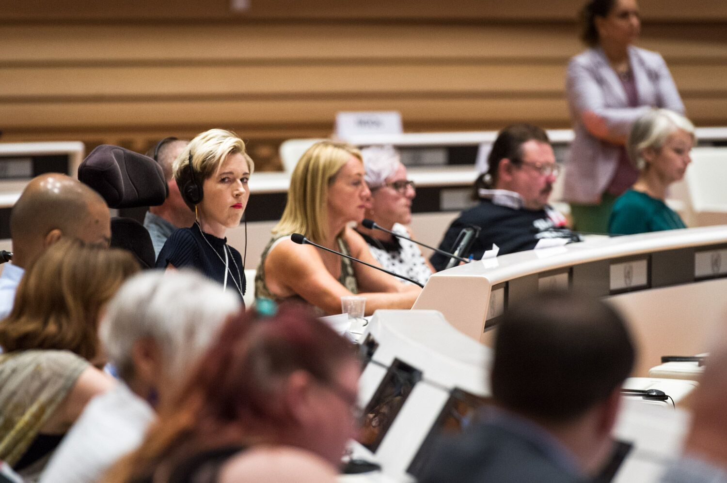
CEDAW and CRPD very similar
Sarah Rennie, from Sisters of Frida, part of the UK disabled people s delegation to the UN CRPD 2017, Geneva

Slide 11
DPAC Triggers UN Inquiry Into Grave and Systematic Violations of Disabled People’s Rights
The UN Inquiry and UN visit to the UK to examine the grave and systematic violations of the UN Convention on the Rights of Persons with Disabilities (UNCRPD) was initiated by DPAC.

Slide 12
In May 2013, after 3 years of onslaught against disabled people by the Condem government, DPAC made a formal submission under the CRPD Optional Protocol which establishes an individual complaints mechanism for the Convention.
This inquiry is the first of its kind – it has great historic importance. It means the UN will examine the vicious and punitive attacks on disabled people’s independent living as well as the cuts which have seen so many placed in inhumane circumstances and has led to unnecessary deaths.

Slide 13
A ‘human catastrophe’ – New UN condemnation for UK human rights record
The UK Government’s claim to be a ‘world leader in disability issues’ has today been crushed by the UN Committee on the Rights of Persons with Disabilities. The Committee has released damning Concluding Observations on the UK, following its first Review of the government’s compliance with the Convention.
The Observations conclude last week’s public examination of the UK Government’s record on delivering disabled people’s rights. The examination was declared by the UK rapporteur Mr Stig Langvad, to be “the most challenging exercise in the history of the Committee”. Mr Langvad raised deep concerns on the UK Government’s failure to implement the rights of disabled people. He also noted the government’s “lack of recognition of the findings and recommendations of the (2016) Inquiry” which found ‘grave and systematic violations of disabled people’s human rights’.

Slide 14
Disabled women and CEDAW
Involvement of Disabled Women: Nothing about us without us
See http://www.sisofrida.org/involvement-of-disabled-women-nothing-about-us-without-us/

Slide 15
Disabled women and CEDAW
We did not have much space in the CRPD shadow report but we will build on with CEDAW.
We want to underline the intersecting oppression of the cuts on benefits and services on disabled women.
There are specific issues that affect disabled women such as domestic violence and women’s health issue
We look forward to collaborating with all of you,
Thank you.
Our email: hello@sisofrida.org
Website www.sisofrida.org
Twitter @sisofrida

